Slide 1
EECS 2500 Linear Data Structures
Lecture 15
Chapter 06 – (General) Lists – Part 1
Fall 2016
Dr. Larry G. Thomas – University of Toledo/LCCC

Slide 2
Welcome to EECS 2500
Pages of primary text in each chapter:
Ch. 1: 62 pp. (Getting Organized)
Ch. 2: 96 pp. (Abstract Data Types (ADTs))
Ch. 3: 84 pp. (The Stack ADT)
Ch. 4: 54 pp. (Recursion)
Ch. 5: 86 pp. (The Queue ADT)
Ch. 6: 90 pp. (The List ADT)
Ch. 7: 58 pp. (More Lists)
Ch. 8: 82 pp. (Binary Search Trees – skip)
Ch. 9: 58 pp. (Priority Queues, Heaps, and Graphs – skip)
Ch. 10: 78 pp. (Searching and Sorting Algorithms – partial)

Slide 3
Chapter Outline
6.1 – Comparing Objects Revisited
6.2 – Lists
6.3 – Formal Specification
6.4 – Array-Based Implementation
6.5 – Applications: Poker, Golf, and Music
6.6 – The Binary Search Algorithm
6.7 – Reference-Based Implementations
6.8 – Storing Objects and Structures in Files

Slide 4
Comparing Objects Revisited (§6.1)
Many list operations require us to compare the values of objects, for example:
Check whether a given item is on our to-do list
Insert a name into a list in alphabetical order
Delete the entry with the matching serial number from a parts inventory list
Therefore we need to understand our options for such comparisons.

Slide 5
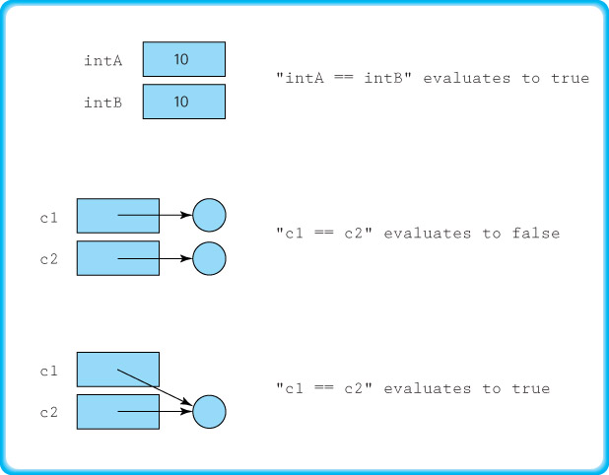
Using the comparison (==) operator

Slide 6
Using the equals Method
Since equals is exported from the Object class it can be used with any Java objects.
For example, If c1 and c2 are objects of the class Circle, then we can compare them using
c1.equals(c2)
But this method, as defined in the Object class, acts much the same as the comparison operator: It returns true if and only if the two variables reference the same object.
However, we can redefine (i.e., override) the equals method to fit the needs of the class.

Slide 7
Using the equals Method (2)
A reasonable definition for equality of Circle objects is that they’re equal if they have equal radii
To realize this approach we define the equals method of our Circle class to use the radius attribute:
public boolean equals(Circle circle)
{
// Precondition: circle != null
//
// Returns true if the circles have the same radius,
// otherwise returns false.
if (this.radius == circle.radius)
return true;
else
return false;
}

Slide 8
Using the equals Method (2)
A reasonable definition for equality of Circle objects is that they’re equal if they have equal radii
To realize this approach we define the equals method of our Circle class to use the radius attribute:
public boolean equals(Circle circle)
{
// Precondition: circle != null
//
// Returns true if the circles have the same radius,
// otherwise returns false.
return (this.radius == circle.radius);
}

Slide 9
Ordering Objects
In addition to checking objects for equality, there is another type of comparison we need.
Stacks and queues order items based on when they arrive at the data structure (temporal order)
Sometimes, the data itself determines the order
To support a sorted list we need to be able to tell when one object is less than, equal to, or greater than another object.
The Java library provides an interface, called Comparable, which can be used to ensure that a class provides this functionality.

Slide 10
The Comparable Interface
The Comparable interface consists of exactly one abstract method
public int compareTo(Object o);
// Returns a negative integer, zero, or a positive
// integer as this object is less than, equal to,
// or greater than the specified object (resp).
The CompareTo method returns an integer value that indicates the relative "size" relationship between the object upon which the method is invoked and the object passed to the method as an argument.

Slide 11
Using the Comparable Interface
Objects of a class that implements the Comparable interface are called Comparable objects.
To ensure that all elements placed on our sorted list support the compareTo operation, we require them to be Comparable objects.
For example, see the definition of compareTo for our Circle class on the next slide …

Slide 12
A compareTo Example
public int compareTo(Circle circle)
// Precondition: circle != null
//
// Returns a negative integer, zero, or a positive integer if this circle
// is less than, equal to, or greater than the parameter circle.
{
if (this.radius < circle.radius) return -1;
if (this.radius == circle.radius) return 0;
return 1;
}
Note that the equals method and the compareTo method of our Circle class are compatible with each other.
To simplify discussion we sometimes refer to the attribute, or combination of attributes, of an object used by the compareTo method to determine the logical order of a collection as the key of the collection.

Slide 13
A compareTo Example
public int compareTo(Circle circle)
// Precondition: circle != null
//
// Returns a negative integer, zero, or a positive integer if this circle // is less than, equal to, or greater than the parameter circle.
{
if (this.radius < circle.radius) return -1;
if (this.radius == circle.radius) return 0;
else return 1;
}
Why will Java not allow this version of the code?

Slide 14
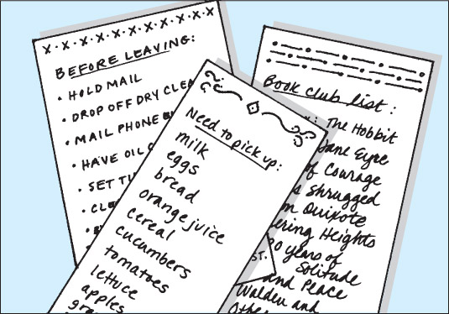
Lists - Definitions (§6.2)
List: A collection that exhibits a linear relationship among its elements
Linear relationship: Each element except the first has a unique predecessor, and each element except the last has a unique successor
Size: The number of elements in a list; the size can vary over time

Slide 15
Varieties of Lists
Unsorted list: A list in which elements are placed in no particular order; the only relationship between data elements is the list predecessor and successor relationships
Sorted list: A list that is sorted by some property of its elements; there is an ordered relationship among the elements in the list, reflected by their relative positions
Indexed list: A list in which each element has an index value associated with it

Slide 16
Assumptions for Our Lists
Our lists are unbounded
If we use an array-based implementation and run into the limit imposed by the array size, we’ll create a new, larger underlying array
We allow duplicate elements on our lists
We do not support null elements
Other than prohibiting null elements, we have minimal preconditions on our operations
Rather than requiring more preconditions (like “item must be on the list before we can delete it”), we return true if we were successful and false if not – for any of several potential reasons

Slide 17
Assumptions for Our Lists (2)
Our sorted lists are sorted in increasing order (i.e., ascending order), as defined by the compareTo operation applied to list objects
The equals and compareTo methods of our sorted list elements are consistent
In our indexed lists, the indices in use at any given time are contiguous, starting at 0

Slide 18
Formal Specification (§6.3)
We define a small, but useful, set of operations for use with our lists.
We capture the formal specifications of our List ADT using the Java interface construct.
We pull all the common list method descriptions together into a single interface, called ListInterface.
We then extend the ListInterface with an additional interface for indexed lists, because there are more operations available on an indexed list

Slide 19
List Iteration
Because a list has a linear relationship among its elements, we can support iteration through a list.
Iteration means that we provide a mechanism to process the entire list, element by element, from the first element to the last element.
Each of our list variations provides the operations reset and getNext to support this activity.

Slide 20
List Operations (1)
Our list interface defines the following operations:
size: Returns the number of elements on the list
add: Adds an element to the list
contains: Passed an Object argument and returns a boolean indicating whether the list contains an equivalent element
remove: Passed an Object argument and, if an equivalent element exists on the list, removes one instance of that element. Returns a boolean value indicating whether an object was actually removed
get: Passed an Object argument, returns an equivalent Object if one exists on the list. If not, returns null
toString: Returns a nicely formatted string representing the contents of the entire list.

Slide 21
List Operations (2)
Our list interface defines the following operations, cont’d:
reset: Initializes the list. Sets the current position (the position of the next element to be processed) to the first element on the list.
getNext: Returns the next element, and updates the current position.

Slide 22
List Operations (3)
Our Indexed List also supports several index-based operations
Each method that accepts an index as an argument throws an exception if the index is invalid.
The index-based operations:
add: Given an Object element and an integer index, adds the element to the list at the position index
set: Given an Object element and an integer index, replaces the current element at the position index with the argument element
get: Passed an integer index it returns a reference to the element from the list at that position
indexOf: Given an Object element, returns the index of the first such matching element (or -1 if no matching element is in the list)

Slide 23
List Operations (4)
The index-based operations (cont’d):
remove: Passed an integer index, it removes the element at that position

Slide 24
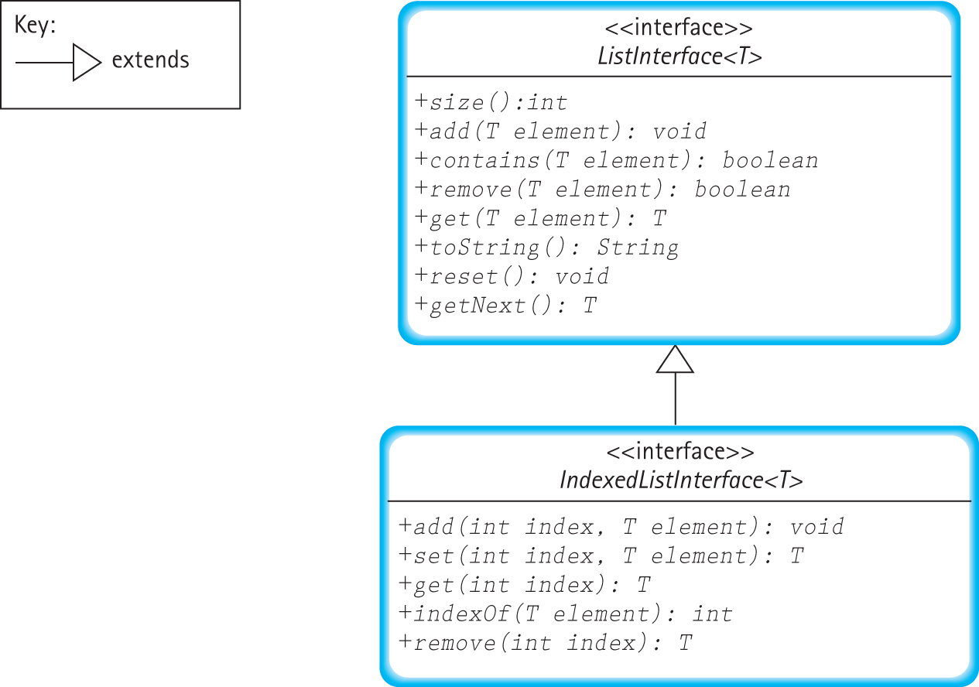
UML Diagram of our List Interfaces

Slide 25
List Example
Code Section
ListInterface<String> list1 = new ArrayUnsortedList<String>(3);
list1.add("Wirth");
list1.add("Dykstra");
list1.add("DePasquale");
list1.add("Dahl");
list1.add("Nygaard");
list1.remove(“DePasquale");
ListInterface<String> list2 = new ArraySortedList<String>(3);
list2.add("Wirth");
list2.add("Dykstra");
list2.add("DePasquale");
list2.add("Dahl");
list2.add("Nygaard");
list2.remove("DePasquale");
IndexedListInterface<String> list3 = new ArrayIndexedList<String>(3);
list3.add(0, "Wirth");
list3.add(0, "Dykstra");
list3.add(0, "DePasquale");
list3.add(3, "Dahl");
list3.add(2, "Nygaard");
list3.remove("DePasquale");
System.out.println("Unsorted " + list1);
System.out.println("Sorted " + list2);
System.out.println("Indexed " + list3);
Output
Unsorted List:
Wirth
Dykstra
Dahl
Nygaard
Sorted List:
Dahl
Dykstra
Nygaard
Wirth
Indexed List:
[0] Dykstra
[1] Wirth
[2] Nygaard
[3] Dahl

Slide 26

Array-Based Implementation (§6.4)
Reference-based approach is in §6.7
Basic Array-based Approach:
We’re storing abbreviated South American countries:

Slide 27
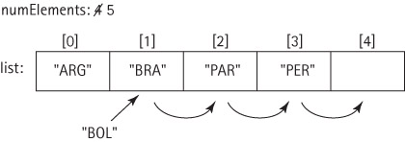
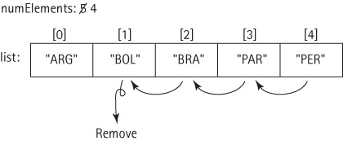
Adding / Removing From the Middle

Slide 28
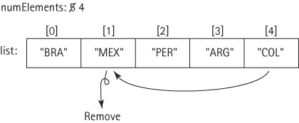
The ArrayUnsortedList Class
Implements the UnsortedListInterface
We can improve the remove method:
When we delete an item from the middle of the list, because the list doesn’t need to maintain any particular order, we can “fill the gap” with the last item on the list, rather than shifting the intervening items.
See pp. 399 – 403

Slide 29
The ArraySortedList Class
Implements the ListInterface using an array
Extends ArrayUnsortedList
The remove method maintains sorted order
The add method:
Checks to make sure there’s room for the insertion. If not, it calls enlarge() to make room
Finds the place where the new item belongs
Creates a space in which to store the new item (moves everything down one slot)
Puts the new item in the created opening

Slide 30
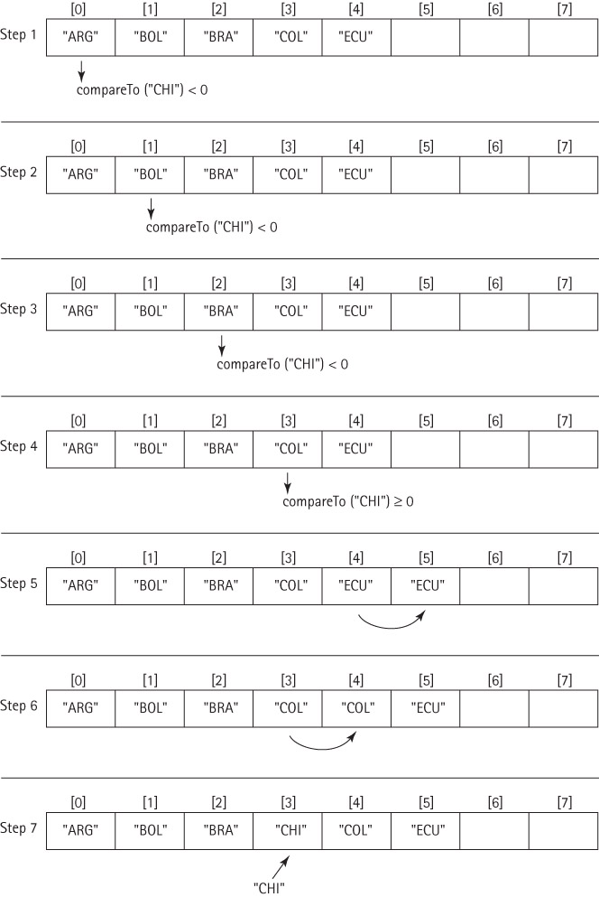
Inserting “CHI”

Slide 31
The SortedList add Method (pp. 406-7)
public void add(T element)
// Adds element to this list.
{
T listElement;
int location = 0;
if (numElements == list.length) enlarge();
while (location < numElements)
{
listElement = (T)list[location];
if (((Comparable)listElement).compareTo(element) < 0)
location++; // List element < Add Element
else
break; // List element >= Add Element
}
for (int index = numElements; index > location; index--)
list[index] = list[index - 1]; // Make room for new item
list[location] = element; // Place new item
numElements++; // Now there’s one more item
}

Slide 32
ADTs “by Copy” or “by Reference”
When designing an ADT we have a choice about how to handle the elements—“by copy” or “by reference.” – see pp. 407 – 411
By Copy: The ADT manipulates copies of the data used in the client program. Making a valid copy of an object can be a complicated process, but it does ensure that the client doesn’t inadvertently corrupt the data
By Reference: The ADT manipulates references to the actual elements passed to it by the client program. This is the most commonly used approach and is the approach we use throughout this textbook.

Slide 33
“By Copy” Notes
Valid copies of an object are typically created using the object's clone method.
Classes that provide a clone method must indicate this to the runtime system by implementing the Cloneable interface.
Drawbacks:
Copy of object might not reflect up-to-date status of original object
Copying objects takes time, especially if the objects are large and require complicated deep-copying.
Storing extra copies of objects requires extra memory.

Slide 34
“By Reference” Notes
Because the client program retains a reference to the element, we say we have exposed the contents of the collection ADT to the client program.
“By Reference” takes less memory and runs faster
It uses aliases, so we get all of the good and the bad that comes with aliasing references.
If our elements are immutable (i.e., can’t change), then there are no problems.

Slide 35
“By Reference” Notes (2)
The ADT allows direct access to the individual elements of the collection by the client program through the client program’s own references.
Drawbacks:
We create aliases of our elements, so we must deal with the potential problems associated with aliases.
This situation is especially dangerous if the client program can use an alias to change an attribute of an element that is used by the ADT to determine the underlying organization of the elements – for example if it changes the key value for an element stored in a sorted list.

Slide 36
An Example
The next three slides show the results of a sequence of operations when each of the two approaches is used to store a sorted list:
We have three objects that hold a person’s name and weight (next slide – Step 1)
We add the three objects onto a list that sorts objects by the variable weight
We transform one of the original objects with a diet method, which changes the weight of the object
That can create either of two problems, as we shall see

Slide 37
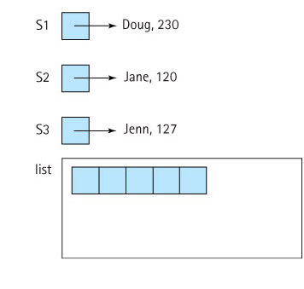
Example – Step 1
By Copy Approach By Reference Approach

Slide 38
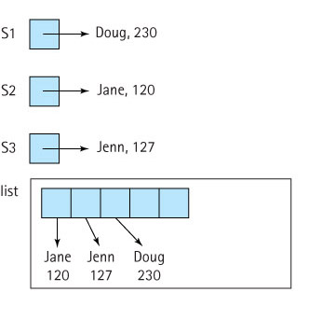
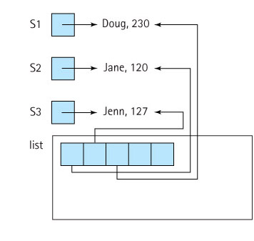
Step 2 – Add Objects to the List
By Copy Approach By Reference Approach

Slide 39
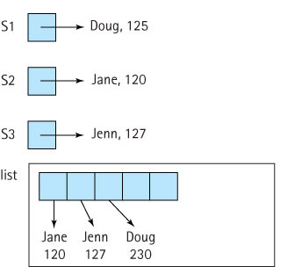
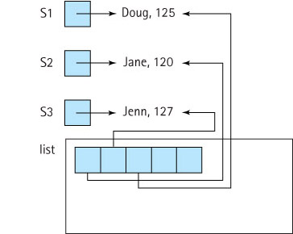
Step 3: Execute S1.diet(-105)
By Copy Approach By Reference Approach
Problem: List copy is out of date Problem: List is no longer sorted

Slide 40
Which Approach Is Better?
Like most things in life -- it depends.
If processing time and space are issues, and if we are comfortable counting on the application programs to behave properly, then the “by reference” approach is probably best.
If we’re not too concerned about time and space (maybe our list objects are not too large), but we are concerned with maintaining careful control over the access to and integrity of our lists, then the “by copy” approach is probably best.
The suitability of either approach depends on what the list is used for.

Slide 41
The ArrayIndexedList Class
Implements the IndexedListInterface
Extends ArrayUnsortedList with the required methods for creation and use of an indexed list:
void add(int index, T element)
void set(int index, T element)
T get(int index)
int indexOf(T element)
T remove(int index)
The implementations are straightforward
Overrides the toString method of the ArrayUnsortedList class

Slide 42
Chapter 6 Will Continue…
? Questions ?

